Slide 1



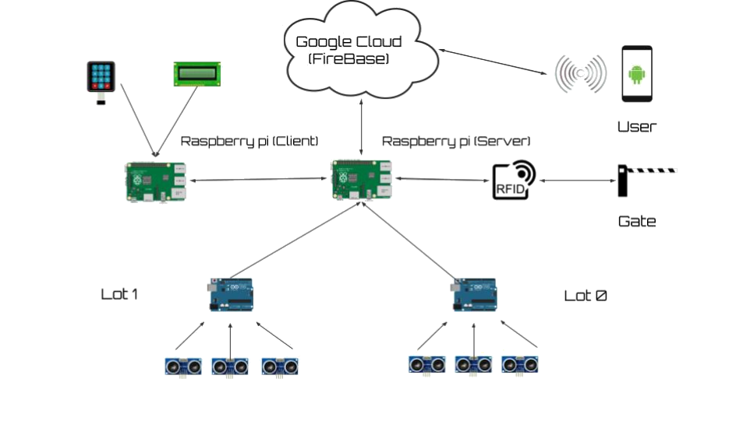











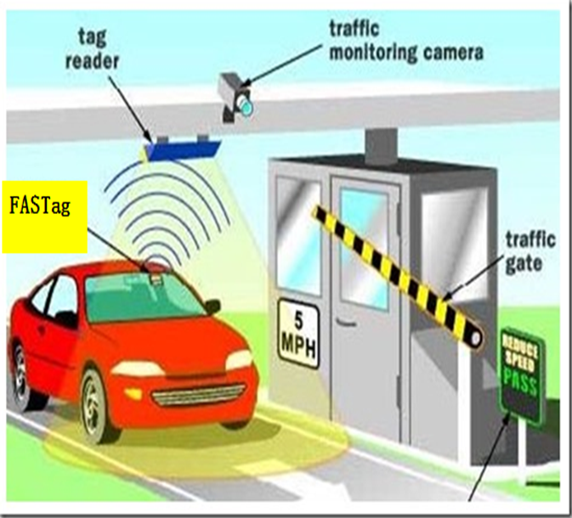

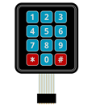
Free Parking Spot
(FPS)
Frands Charles, Akram Mouaddah, Nery Ruiz
Department of Computer Science and Engineering
University of Bridgeport, Bridgeport, CT
Abstract
Introduction
Students who own cars, sometimes have problems finding a free parking spot inside the campus, making them looking around from a parking lot to another. So, they end up wasting time and fuel while looking. If the Driver has the information about the parking spot, if it’s occupied or not, he will know where to go directly, and by that, he will save time and fuel.
The Internet of Thing is an evolving modern type of communication that has as a vision, the integration of many technologies in one network, gathering data, larger connectivity using the clouds and mainly, simplifies users’ daily life. Our project F.P.S (Free Parking Spot) is an IoT based system that falls within the same vision of the IoT. F.P.S uses different types of communication (Wireless and wired), collect data from distance sensors and store it in a database located in the cloud allowing access to the information from anywhere in the world.
Proposal
We propose as a solution to this problem, an IoT based system responsible for gathering data from distance sensors (Ultrasonic Sensors) to figure out if the parking spot is used or free to use. The information collected from the sensors will be sent to a cloud (Database) responsible for storing the data. Users will have an app allowing them to request the status of each spot and provide navigation to the parking lot.
.
Structure
Diagram
Parts Name | Description
 | Raspberry Pi 3B+
 | Ultrasonic Sensors | Responsible for sensing if there’s a car in the range of the sensors, if so the status of the parking spot will be collected through Arduino as a binary data
 | Android Device | The app is responsible for requesting the availability of the parking spot After choosing the parking lot, user will be able to choose a spot and get direction to the parking lot
 | Bread Board | We used the breadboard device in our prototype to test circuit design
 | TRI LED (Green & Red) + Resistors | Light up in RED when the gate is closed and light up in GREEN when the gate is open.
 | Jump Wire (Male to Male /Male to female) | Electrical wire used to interconnect the components of the breadboard with other equipment
 | RFID Tags | The RIFID tags are used to authenticate users before they can get access to a perking lot
 | RFID Readers | The RFID tags connected to the cars, and matching the IDs to the ones already stored in the database located in the Raspberry Pi(Server) to allow access to the parking lot or not.
 | Servo Motor | Responsible for the movement of the gate. After allowing the access to the parking lot, the servo motor rotates 90° to open the gate and get back to 0° after a period of time.
 | Prototype Cars | These are car toys used to simulated the free parking spot prototype
 | Arduino Uno | Responsible for gathering the data from the Ultrasonic sensors and transmit them to the Raspberry Pi
 | LCD Scree 16bits | Responsible for displaying “Accepted” when the access is accepted, and “Denied” when the access is denied
 | Keypad Mambran 4x4 | Plays the role of a Back-up for the RFID Tag, users will have to type their ID through the keypad to get access to the parking lot.
Concept
Using ultrasonic sensors to gather data from parking spot to figured if parking is available
The information collected will be sent to the cloud and will be updated every thirty second
This data will be available to users via the mobile app
Each gate will be equipped with RFID reader enabling the RIFD tag in each car to authenticate parking permission at the parking lot
Conclusions
This project will serve many users to save time energy and gas, provided accurate information about the availability of each parking spot. To fulfilled this vision we used all we learned in IOT class and the previous classes. As implementers of this prototype we learned to integrated different types of technology to function as one. This project is the realization of many technologies in one network and the benefit from data anywhere and anytime, we used three different coding languages (Java, Python and C++) and different ways of communication (Wired, wireless and web sockets) grouped in one small network able to connect to the cloud and provide the service we needed.
Acknowledgements
Thank you to the University of Bridgeport and instructor Dr. Abdelshakour Abuzneid and graduate assistant Rania Baashirah, and also to all the students (Internet of Things (IOT), Spring 2019). A final thanks to Nery Ruiz, Akram Mouaddah and Frands Charles for their hard work and dedication.

